Slide 1
Prophet Wutang
Isaac Duarte, Anthony Girard, Yinuo Zhang

Slide 2

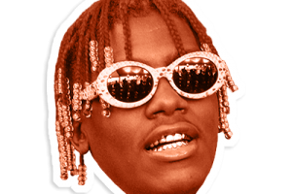
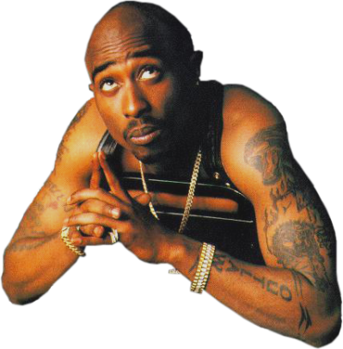

Prophet Wutang
Isaac Duarte, Anthony Girard, Yinuo Zhang

Slide 3
Why should we care?

Slide 4
Why should we care?
Hip-hop has become a major genre and people listen to hip-hop music everyday

Slide 5
Why should we care?
Hip-hop has become a major genre and people listen to hip-hop music everyday
Hip-hop lyrics are a very interesting language corpus

Slide 6
Why should we care?
Hip-hop has become a major genre and people listen to hip-hop music everyday
Hip-hop lyrics are a very interesting language corpus
Hip-hop has an emphasis on lyrics, which adds to its social meaning

Slide 7
Why should we care?
Hip-hop has become a major genre and people listen to hip-hop music everyday
Hip-hop lyrics are a very interesting language corpus
Hip-hop has an emphasis on lyrics, which adds to its social meaning
⇒ If we can analyze trends in Hip-hop as time goes by, we can tell how the society has changed over time from one perspective

Slide 8
Background
Things previously done:
Predicting genre from lyrics
Commercial success from lyrics

Slide 9
Background
Things previously done:
Predicting genre from lyrics
Commercial success from lyrics
Would like to know what sort of syntax/words are used in hip hop lyrics but Topic Modeling is difficult because of metaphorical language, repetition, and other non standard language
How is hip hop evolving? Can we use trends to predict when a song was released

Slide 10
What did we get?

Slide 11
Prophet Wutang - A released-date predictor
Powered by TensorFlow with Logistic Regression and RNN
Trained on over 17k Hip-hop songs spanning over 40 years
Predicts the released date range of a given song
Generates a word cloud for each of the decades

Slide 12
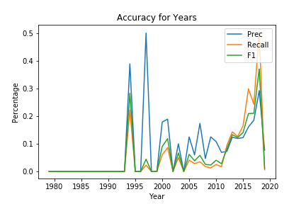
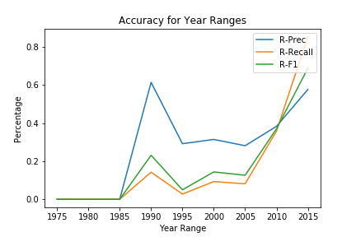
Results
1997
1994
Accuracy: 17.1%
Accuracy : 50.11%

Slide 13
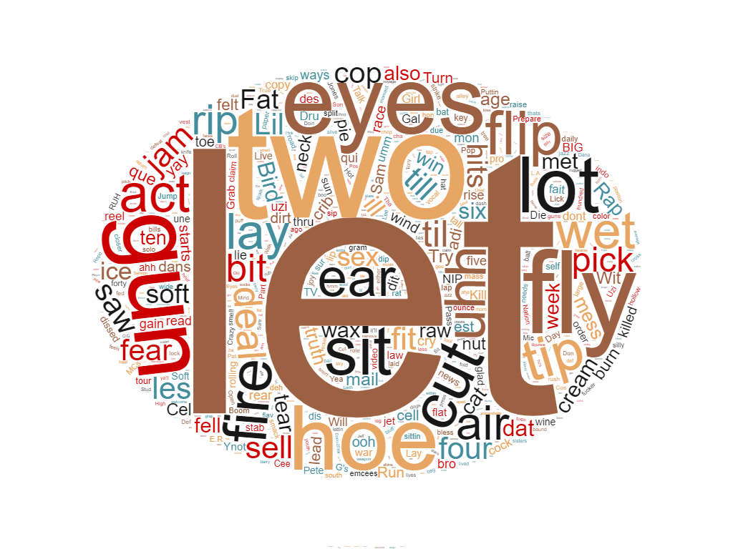
1975-1979
1980-1984
1985-1989
2010-2014
2015-2019
(an attempt on topic modeling)
Word cloud 1990-1994

Slide 14
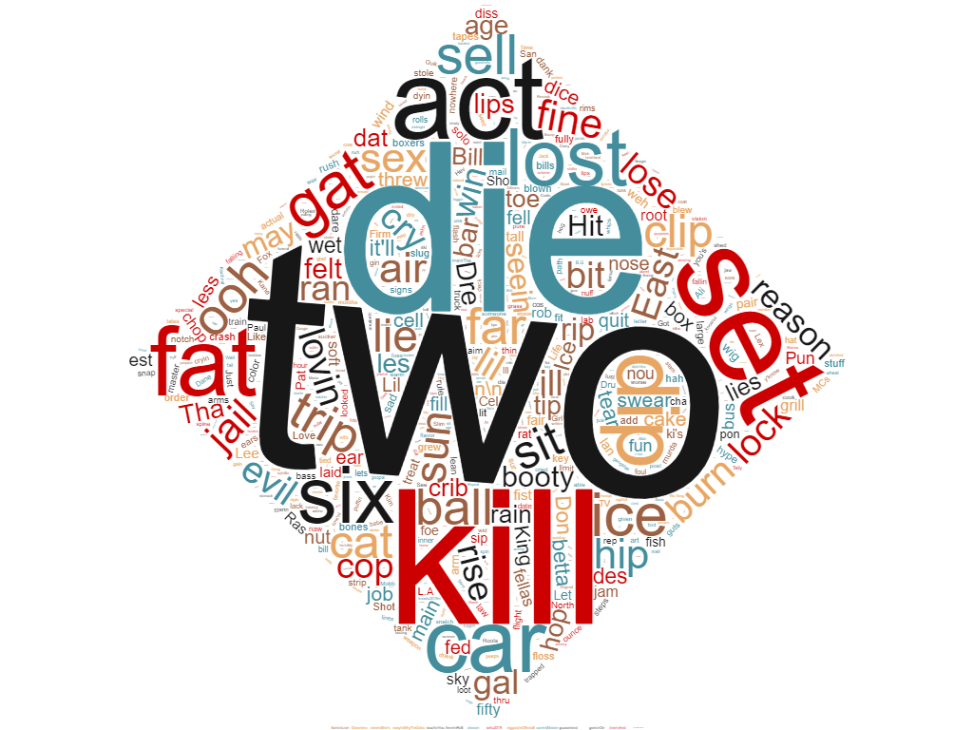
Word cloud 1995-1999

Slide 15
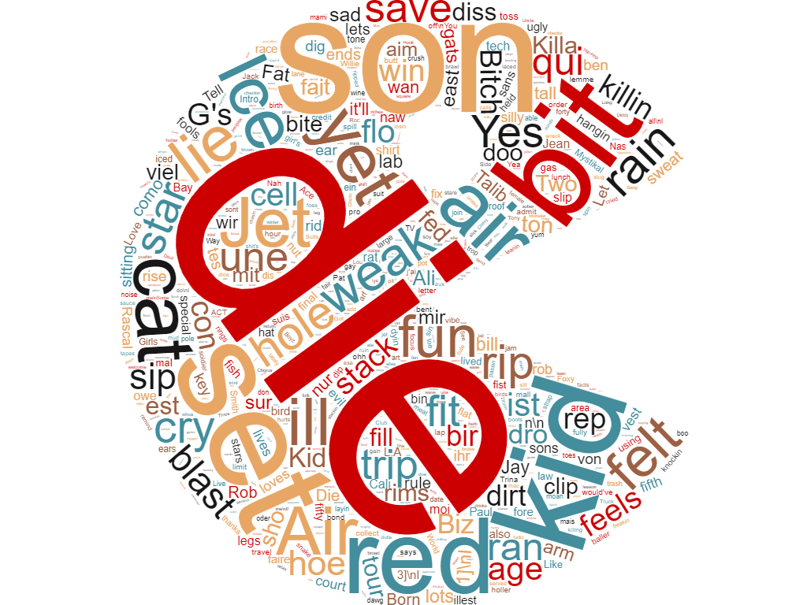
Word cloud 2000-2004

Slide 16
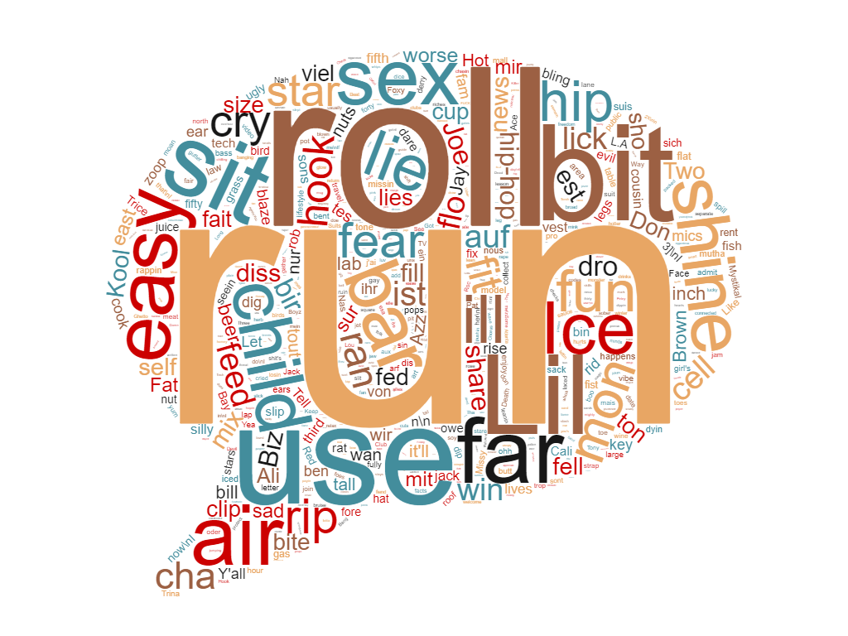
Word cloud 2005-2009

Slide 17
Top Topics
2010-2014
0: im like got know dont just verse aint nigga shit',
1: feeling rise summer voice homie uh zone game getting gettin',
2: zone future girlfriend girl gimme ghost getting gettin gets gave',
3: mi shorty fear trip brother zone games gang gangsta gas',
4: zone future girlfriend girl gimme ghost getting gettin gets gave',
5: zone future girlfriend girl gimme ghost getting gettin gets gave',
6: zone future girlfriend girl gimme ghost getting gettin gets gave',
7: barely ni freak amazing money ring fear room screaming mama',
8: zone future girlfriend girl gimme ghost getting gettin gets gave',
9: im like got know dont just verse aint nigga shit'

Slide 18
How did we achieve this?

Slide 19
Prophet Wutang - Workflow
List of rappers obtained from Wikipedia’s “List of Hip Hop Musicians”

Slide 20
Prophet Wutang - Workflow
List of rappers obtained from Wikipedia’s “List of Hip Hop Musicians”
Top hits from these musicians collected on Genius artist page

Slide 21
Prophet Wutang - Workflow
List of rappers obtained from Wikipedia’s “List of Hip Hop Musicians”
Top hits from these musicians collected on Genius artist page
Lyrics obtained via Genius API + HTML web scraping

Slide 22
Prophet Wutang - Workflow
List of rappers obtained from Wikipedia’s “List of Hip Hop Musicians”
Top hits from these musicians collected on Genius artist page
Lyrics obtained via Genius API + HTML web scraping
Creating the training model

Slide 23
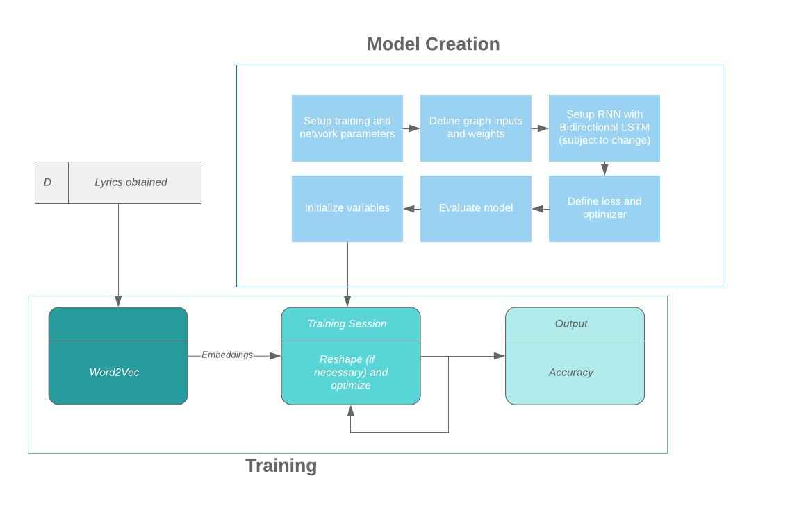
Workflow

Slide 24
Demo
🔥🔥🔥
Let’s pull up a song and see 😈😈😈

Slide 25
Conclusion

Slide 26
Conclusion
Hip hop lyrics have evolved, while retaining some characteristics. Word clouds demonstrate this

Slide 27
Conclusion
Hip hop lyrics have evolved, while retaining some characteristics. Word clouds demonstrate this
Word clouds contain many words “good” for rhyming

Slide 28
Conclusion
Hip hop lyrics have evolved, while retaining some characteristics. Word clouds demonstrate this
Word clouds contain many words “good” for rhyming
Increasingly materialistic?

Slide 29
Conclusion
Hip hop lyrics have evolved, while retaining some characteristics. Word clouds demonstrate this
Word clouds contain many words “good” for rhyming
Increasingly materialistic?
Decreasingly violent

Slide 30
Thank you!

